Slide 1
Как добавить искусственный интеллект в реальные проекты с помощью Azure Machine Learning
Виктор Цикунов Майкрософт Украина

Slide 2

Что такое Azure?
Как работает Azure Machine Learning?
Содержание
Демо
Какие задачи можно решать

Slide 3
16 регионов в мире в 2014
Azure footprint
Дата центры
Региональные партнеры

Slide 4
>57%
>300k
More than
1,000,000
Fortune 500 using Azure
Active websites
SQL Databases in Azure
>30
>300
>1.65
TRILLION storage objects
MILLION
AAD users
>3
MILLION requests/sec
>13
BILLION
MILLION
authentication/wk
Developers registered with Visual Studio Online

Slide 5






Microsoft Azure Services
Office Add-in
PC
Tablet
Phone
Browser
Games console
On-premises service
On-premises database
Client layer
(on-premises)
Access Control
Layer
AD
Multifactor
Authentication
BizTalk Services
Service Bus
CDN
Traffic Manager
Virtual Networks
Express Route
Integration
layer
API Mgmt
Mobile Services
Websites
Cloud Services
VM
Media Services
Notification Hubs
Scheduler
Automation
Application
layer
Blobs
Tables
Queues
SQL Database
Machine Learning
HD Insight
Caching
Backup and Recovery
StorSimple
Data Layer
Storage
Data

Slide 6
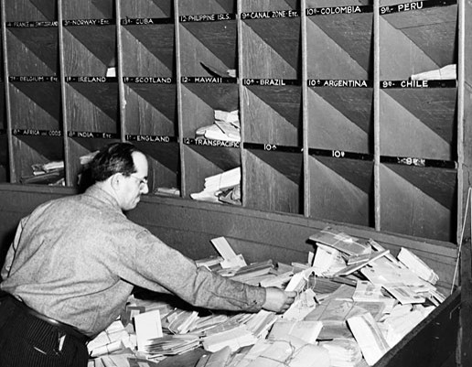
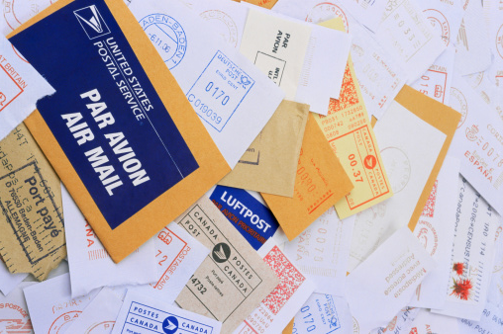
Почта США обрабатывает более 150 миллиардов писем и посылок за год – слишком много для эффективной ручной сортировки.
Не так давно, в 1997, только 10% корреспонденции с написанным рукой адресом сортировалось автоматически.
Notes:
Last year the United States Postal Service processed 150 Billion pieces of mail – far to much for efficient human sorting, but as recently as 1997, only 10% of all the hand-addressed mail was sorted automatically. Why?
https://about.usps.com/who-we-are/postal-facts/size-scope.htm
http://en.wikipedia.org/wiki/Handwritten_Address_Interpretation

Slide 7

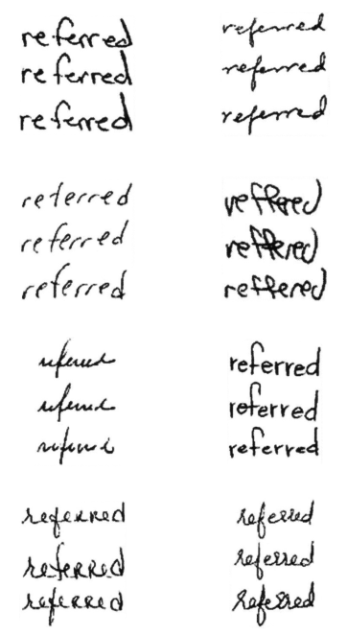
Проблема автоматизации в обучении компьютеров понимать бесконечные вариации рукописного текста
Notes:
Because this is a tough problem – the type of problem machine learning is designed to solve. It has taken so many years to automate the sorting of the mail because reading handwriting is hard due to all the variables involved. Even humans have trouble reading other humans’ handwriting, if you can imagine the thousands of ways someone can write a name or address, this is a huge machine learning problem to solve. How can we teach the machine to read the mail and how can the machine learn and get better over time?

Slide 8

Постоянные отзывы помогли почте США обучить таки компьютеры читать рукописный текст.
Сейчас более 98% корреспонденции обрабатываются машинами.
Notes:
The answer is by providing feedback both in terms of humans training the machine learning models and the machine learning from the patterns in the data over time. By providing feedback, the Postal Service was able to train computers to accurately read human handwriting. This is where the “learning” part of machine learning comes in. Data scientists created a model based on all the data they had on how people can write addresses. Then they train the model as more data comes in, correcting attempts at reading handwriting when they’re off, until the model has enough of a history to draw from that it can accurately read handwriting.
Today, with the help of machine learning, over 98% of all mail is successfully processed by machines.
https://about.usps.com/who-we-are/postal-facts/size-scope.htm
http://en.wikipedia.org/wiki/Handwritten_Address_Interpretation

Slide 9

Microsoft & Machine Learning 15 лет инноваций
1999
2004
2005
2008
2010
2012
2014
Фильтрация СПАМа
Поисковые системы Microsoft начали использовать Data Mining
SQL Server Получил функции Data Mining
Bing Maps начали исполь- зовать ML механизмы для предсказания трафика
Microsoft Kinect понимает жесты людей
Успешное распознавание голоса в реальном времени
Microsoft запускает Azure Machine Learning
Машинное обучение широко распространено во всех продуктах Microsoft.
“
John Platt, Distinguished scientist at Microsoft Research
”
Notes:
Back in the 90s when the post office was wrestling with this issue, we were also working on Machine Learning, starting in 1991 when Microsoft Research was formed.
As early as 1999 they were using it to help create email filters by predicting which emails were junk, and which were relevant.
And as John Platt mentions—it’s a key technology that Microsoft uses to develop its own software. In 2004. Machine learning was part of Microsoft’s search engine
It is also used in Bing Maps as part of the traffic prediction service.
And many people know about how it was a key technology to make Kinect a reality, letting computers track people’s gestures and sort through what’s relevant and what’s not. Like filtering out a dog in the background to see a player’s movements.
And today, this technology that has been developed over decades is becoming available commercially as part of Azure
It’s this depth of experience with machine learning, testing and refining over years, using it to develop pretty much all Microsoft products, that makes Microsoft’s solution so robust.

Slide 10

Azure ML - как это работает?
Web Apps
Mobile Apps
PowerBI/Dashboards
ML API service
Разработчик
Azure Portal
ML Studio
Azure Portal & ML API service
HDInsight
Azure Storage
Azure Ops Team
Аналитик
Desktop Data
Notes:
Let’s walk through how a machine learning solution comes to life, from setting up the environment to extracting insight.
First, The Azure ops team, maybe already accustomed to managing storage accounts or provisioning Azure virtual machines, can get a machine learning environment set up right from the Azure Portal. They start by creating an ML Studio workspace and dedicated storage account to get their data scientists up and running.
<click>
When the Azure Ops team sets up the data scientist, she’ll get an email to her Windows Live account that gives her one-click to get started.
The data scientist will then spend her time in ML Studio. From there, she can execute every step in the data science workflow.
She can access and prepare data
Create, test and train models, as well as import her company’s proprietary models securely into her private workspace
Work with R and over 300 of the most popular R packages along with Microsoft’s business class algorithms
Collaborate with colleagues within the office or across the globe as easy as clicking “share my workspace”
Deploy models within minutes rather than weeks or months
<click>
And the data scientist has her choice of what data she wants to pull into her models. She can access data already in Azure, query across Big Data in HDInsight, or pull datasets in right from her desktop.
<click>
Once the data scientist is ready to publish, she signals the Azure Ops team. This is when tested models become available to developers via the API service.
<click>
The Azure ops team then uses the ML API service to deploy the model in minutes, making it accessible to developers.
<click>
The developer can surface the model in apps, by simply grabbing auto-generated code and dropping it in. Then business users can access results, from anywhere, on any device. And any model updates simply refresh the model in production with no new development work needed.

Slide 11
Демо
Azure Machine Learning в жизни
Notes:
Now that you know what we’ve built, lets take a look at some real examples.

Slide 12
Использовать данные из прошлого для предсказания будущего
Представьте себе, что машинное обучение может сделать для вашего бизнеса.
Анализ оттока клиентов
Таргетирование рекламы
Выявление и классификация изображений
Мониторинг оборудования
Рекомендации
Прогноз-ирование
Фильтрация СПАМа
Выявление мошенничества
Выявление аномалий
Notes:
It really comes down to Predictive Analytics, using your past data to provide data intelligence about the future. We’ve mentioned a few real world scenarios but there are many more.
Churn analysis to predict which customers may leave and help craft strategies to keep them satisfied
Recommendation engines like what Pier 1 is doing which can leverage huge volumes of customer data to offer customers suggestions of what they might want next.
Fraud detection to flag orders or behaviors which are indicative of a scam and help you stay one step ahead of criminals.

Slide 13
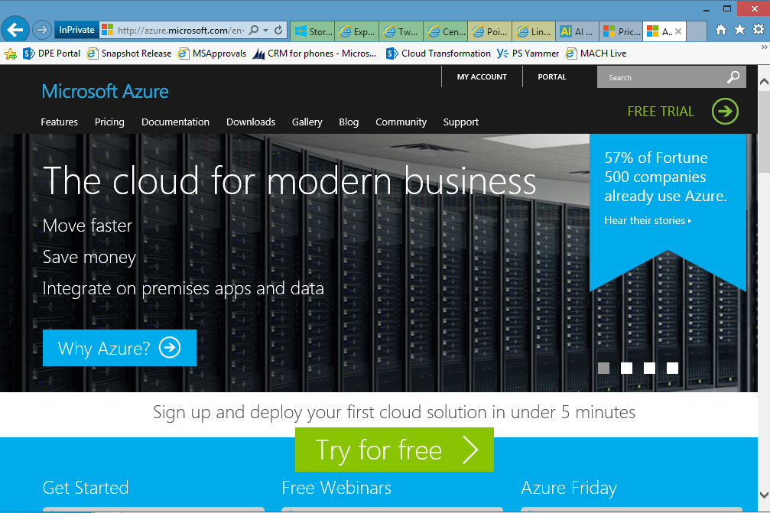
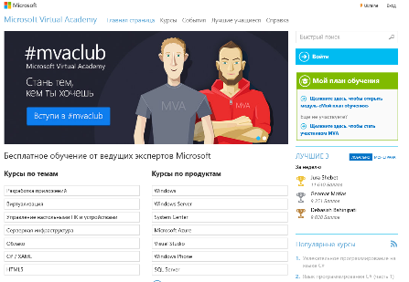
Что дальше?
Зарегистрируйте тестовый экаунт
Azure.com
Группа в Facebook
Facebook.com/ITProCommunity 4. Бесплатные Online курсы
www.MicrosoftVirtualAcademy.com
3. Если Вы спартап – мы предоставляем
все технологии и сервисы бесплатно.
Регистрируйся: Microsoft.com/BizSpark
4. Пишите мне:
e-mail: Viktor.Tsykunov@microsoft.com
Skype: vityabool

Slide 14

azure.com/ml

